Slide 1
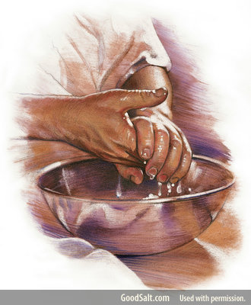
A Clean Hands Parable
A Heart Reality
Mt 15:10-20
Mk 7:14-23
Jn 13:34-35
7/27/25
7/20/25

Slide 2
The Pharisees
complain to Jesus
Then Pharisees and scribes came to Jesus from Jerusalem and said, ² “Why do your disciples break the tradition of the elders? For they do not wash their hands when they eat.”
Mt 15:1-2

Slide 3
The complaint is that
they didn’t wash their hands before eating.
Then Pharisees and scribes came to Jesus from Jerusalem and said, ² “Why do your disciples break the tradition of the elders? For they do not wash their hands when they eat.” Mt 15:1-2

Slide 4
And he called the people to him and said to them, “Hear and understand: ¹¹ it is not what goes into the mouth that defiles a person, but what comes out of the mouth; this defiles a person.” ¹² Then the disciples came and said to him, “Do you know that the Pharisees were offended when they heard this saying?” He answered, “Every plant that my heavenly Father has not planted will be rooted up. ¹⁴ Let them alone; they are blind guides. And if the blind lead the blind, both will fall into a pit.” Mt 15:10-14

Slide 5
¹⁵ But Peter said to him, “Explain the parable to us.” ¹⁶ And he said, “Are you also still without understanding? ¹⁷ Do you not see that whatever goes into the mouth passes into the stomach and is expelled? ¹⁸ But what comes out of the mouth proceeds from the heart, and this defiles a person. ¹⁹ For out of the heart come evil thoughts, murder, adultery, sexual immorality, theft, false witness, slander. ²⁰ These are what defile a person. But to eat with unwashed hands does not defile anyone.” Mt 15:15-20

Slide 6
The parable is about
eating and speaking.
¹⁷ Do you not see that whatever goes into the mouth passes into the stomach and is expelled? ¹⁸ But what comes out of the mouth proceeds from the heart, and this defiles a person. Mt 15:17-18

Slide 7
Not washing hands
broke the Elders tradition.
Then Pharisees and scribes came to Jesus from Jerusalem and said, ² “Why do your disciples break the tradition of the elders? For they do not wash their hands when they eat.” Mt 15:1-2

Slide 8
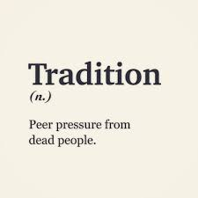

Slide 9
Tradition:
Merriam-Webster
Noun
1a: an inherited, established, or customary pattern of thought, action, or behavior (such as a religious practice or a social custom)
b: a belief or story or a body of beliefs or stories relating to the past that are commonly accepted as historical though not verifiable

Slide 10
Sin is what proceeds
from the
natural human soul.
And Jesus said, “Are you also still without understanding? ¹⁷ Do you not see that whatever goes into the mouth passes into the stomach and is expelled? ¹⁸ But what comes out of the mouth proceeds from the heart, and this defiles a person.” Mt 15:16-18

Slide 11
Will you help me make this BODY a place where HEARTS FIND HEALING?
(not a place of lifeless tradition)

