Slide 1
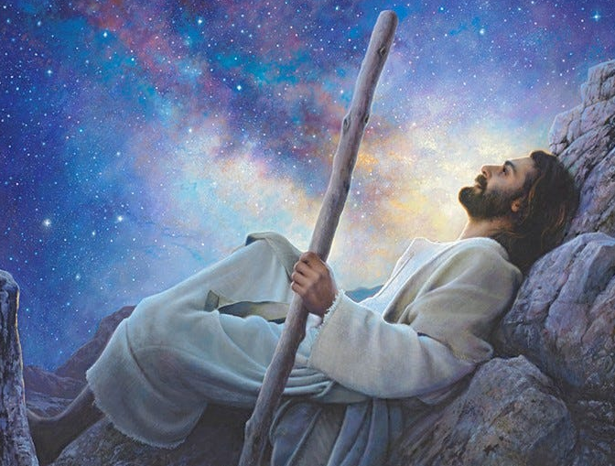
A Desert Mountain Alert
Viewpoint Jesus
Mt 14:22-33
Mk 6:45-51
Jn 6:15-21
Heb 4:16
7/6/25

Slide 2
Immediately he made the disciples get into the boat and go before him to the other side, while he dismissed the crowds. ²³ And after he had dismissed the crowds, he went up on the mountain by himself to pray. When evening came, he was there alone… Mt 14:22-23
Immediately he made his disciples get into the boat and go before him to the other side, to Bethsaida, while he dismissed the crowd. ⁴⁶ And after he had taken leave of them, he went up on the mountain to pray. Mk 6:45-46

Slide 3
but the boat by this time was a long way from the land, beaten by the waves, for the wind was against them. ²⁵ And in the fourth watch of the night he came to them, walking on the sea. ²⁶ But when the disciples saw him walking on the sea, they were terrified, and said, “It is a ghost!” and they cried out in fear. ²⁷ But immediately Jesus spoke to them, saying, “Take heart; it is I. Do not be afraid.”
²⁸ And Peter answered him, “Lord, if it is you, command me to come to you on the water.”
Mt 14:24-28

Slide 4
He said, “Come.” So Peter got out of the boat and walked on the water and came to Jesus. ³⁰ But when he saw the wind, he was afraid, and beginning to sink he cried out, “Lord, save me.” ³¹ Jesus immediately reached out his hand and took hold of him, saying to him, “O you of little faith, why did you doubt?” ³² And when they got into the boat, the wind ceased. ³³ And those in the boat worshiped him, saying, “Truly you are the Son of God.”
Mt 14:29-33

Slide 5
Jesus set a course
for the disciples.
Mt 14:22-23; Mk 6:45-46; Jn 6:15-16
Immediately he made his disciples get into the boat and go before him to the other side, to Bethsaida, while he dismissed the crowd. ⁴⁶ And after he had taken leave of them, he went up on the mountain to pray. Mk 6:45-46

Slide 6
Jesus goes to
the mountain to be alone.
Mt 14:22-23; Mk 6:45-46; Jn 6:15-16
Immediately he made his disciples get into the boat and go before him to the other side, to Bethsaida, while he dismissed the crowd. ⁴⁶ And after he had taken leave of them, he went up on the mountain to pray. Mk 6:45-46

Slide 7
Jesus’ mind was set
on blanketing intimacy.
Mk 6:47-48; Jn 6:18-19
And when evening came, the boat was out on the sea, and he was alone on the land. ⁴⁸ And he saw that they were making headway painfully (3-4 miles- Jn 6:18-19), for the wind was against them. And about the fourth watch of the night he came to them, walking on the sea. He meant to pass by them… Mk 6:47-48

Slide 8
Jesus was fully
aware of the storm.
Mt 14:23-25; Mk 6:47-48; Jn 6:18-19
And after he had dismissed the crowds, he went up on the mountain by himself to pray. When evening came, he was there alone, ²⁴ but the boat by this time was a long way from the land, beaten by the waves, for the wind was against them. ²⁵ And in the fourth watch of the night he came to them, walking on the sea. Mt 14:23-25

Slide 9
Jesus Viewpoint Facts:
He plans to get away Mt 14:23; Mk 6:47; Jn 6:15
- Disciples in a boat to Capernaum
- Crowds dismissed
- By Evening He is alone on the mountain
He spends time with His Father Mk 6:47; Mt 14:23
- During a windstorm
- Knowing His disciples are struggling Mk 6:48
- His time with God is COMPLETE
He goes to His disciples Jn 6:14-15
- Within sight of them – ON WATER
- As if passing by Mk 6:48
- He responds to their needs

Slide 10
Jesus will always come to you in your time of need… His time!
Let us then with confidence draw near to the throne of grace, that we may receive mercy and find grace to help in time of need. Heb 4:16

