Slide 1
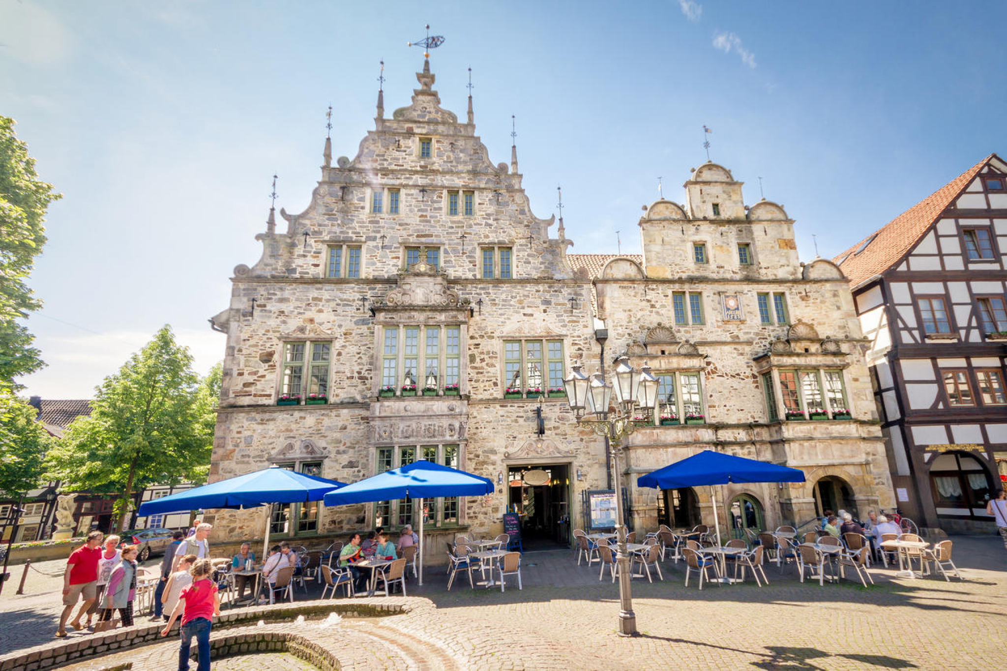
Mountain Prayer
Jesus’ Sabbath
Mt 14:22-24
Mk 6:45-46
Jn 6:15
5/18/25
Rinteln Ratskeller

Slide 2
Immediately he made the disciples get into the boat and go before him to the other side, while he dismissed the crowds. ²³ And after he had dismissed the crowds, he went up on the mountain by himself to pray. When evening came, he was there alone… Mt 14:22-23
Immediately he made his disciples get into the boat and go before him to the other side, to Bethsaida, while he dismissed the crowd. ⁴⁶ And after he had taken leave of them, he went up on the mountain to pray. Mk 6:45-46

Slide 3
These verses show Jesus directing 3 assignments.
Mt 14:22-23, Mk 6:45-46
Immediately he made his disciples get into the boat and go before him to the other side, to Bethsaida, while he dismissed the crowd. ⁴⁶ And after he had taken leave of them, he went up on the mountain to pray. Mk 6:45-46

Slide 4
Assignment 1:
Jesus Disciples to a boat.
Mt 14:22
Immediately he made the disciples get into the boat and go before him to the other side, while he dismissed the crowds. Mt 14:22

Slide 5
Assignment 2:
People to their homes.
Mt 14:22-23
Immediately he made the disciples get into the boat and go before him to the other side, while he dismissed the crowds. ²³ And after he had dismissed the crowds, he went up on the mountain by himself to pray. When evening came, he was there alone… Mt 14:22-23

Slide 6
Assignment 3:
Jesus to be alone.
Mt 14:23
And after he had dismissed the crowds, he went up on the mountain by himself to pray. When evening came, he was there alone…
Mt 14:23

Slide 7
The reasons for these assignments are human need and heavenly empowerment.

Slide 9
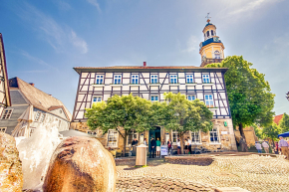

Slide 10
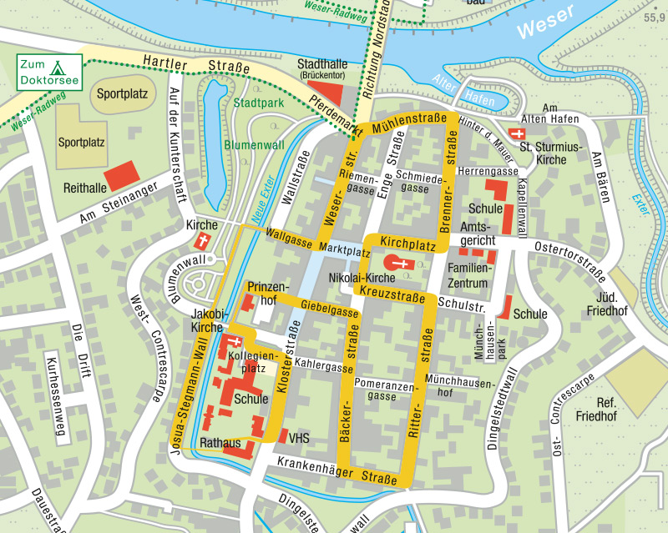

Slide 11
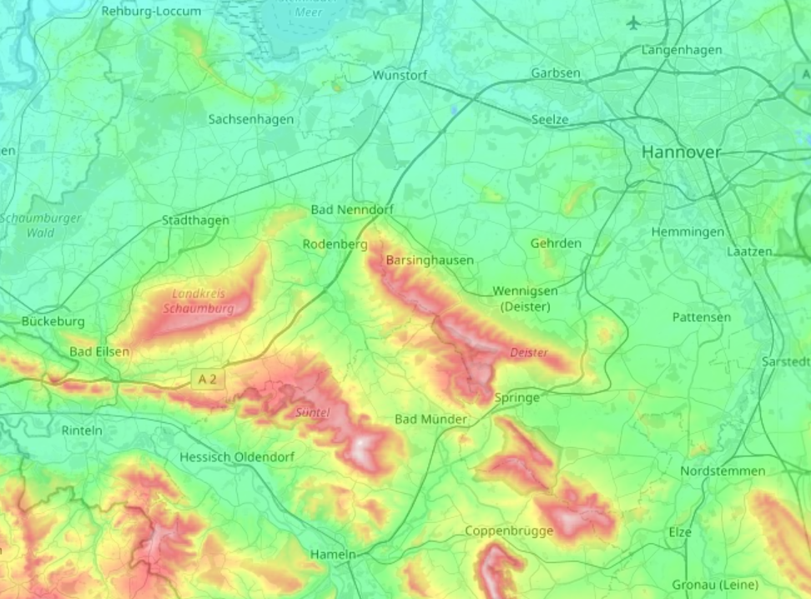

Slide 12
Our Lord is not weary.
Have you not known? Have you not heard? The LORD is the everlasting God, the Creator of the ends of the earth. He does not faint or grow weary; His understanding is unsearchable. ²⁹ He gives power to the faint, and to him who has no might he increases strength. ³⁰ Even youths shall faint and be weary, and young men shall fall exhausted; ³¹ but they who wait for the LORD shall renew their strength; they shall mount up with wings like eagles; they shall run and not be weary; they shall walk and not faint. Is 40:28-31

Slide 13
Jesus is the
bread of life. Jn 16:35, 48
And Jesus said to them, “I am the bread of life. He who comes to Me shall never hunger, and he who believes in Me shall never thirst.” Jn 6:35
Not that anyone has seen the Father, except He who is from God; He has seen the Father. ⁴⁷ Most assuredly, I say to you, he who believes in Me has everlasting life. ⁴⁸ I am the bread of life. Jn 6:46-48

