Slide 1
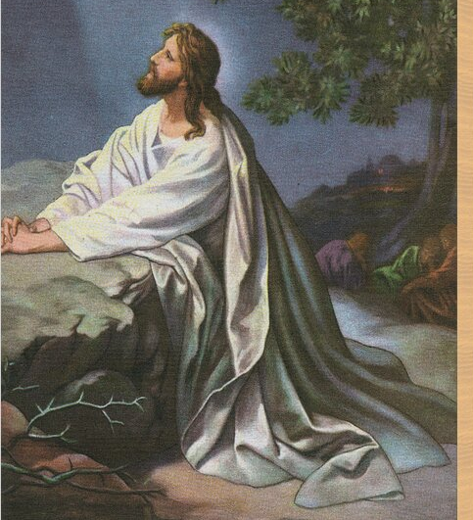
Jesus’ Prayer
Jn 6:1-52
Jn 16:25-33
Jn 17:1-5
Jn 14:1-6, 7-11
Jn 1:11-13
4/27/25

Slide 2
Jesus is
finally being heard.
Jn 16:29
His disciples said, “Ah, now you are speaking plainly and not using figurative speech!
³⁰ Now we know that you know all things and do not need anyone to question you; this is why we believe that you came from God.” Jn 16:29-30

Slide 3
Jesus prays
“The Father.”
Jn 16:26
“These things I have spoken to you in figurative language; but the time is coming when I will no longer speak to you in figurative language, but I will tell you plainly about the Father. ²⁶ In that day you will ask in My name, and I do not say to you that I shall pray The Father for you.” Jn 16:25-26
NKJV

Slide 4
These things I have spoken to you in figurative language; but the time is coming when I will no longer speak to you in figurative language, but I will tell you plainly about the Father. ²⁶ In that day you will ask in My name, and I do not say to you that I shall pray the Father for you; ²⁷ for the Father Himself loves you, because you have loved Me, and have believed that I came forth from God. ²⁸ I came forth from the Father and have come into the world. Again, I leave the world and go to the Father.
Jn 16:25-28

Slide 5
Jesus came forth
from God. Jn 16:30
Now we are sure that You know all things, and have no need that anyone should question You. By this we believe that You came forth from God.”
³¹ Jesus answered them, “Do you now believe? ³² Indeed the hour is coming, yes, has now come, that you will be scattered, each to his own, and will leave Me alone. And yet I am not alone, because the Father is with Me.” Jn 16:30-32

Slide 6
Jesus is the
Eternal Life Giver. Jn 17:2-3
Jesus spoke these words, lifted up His eyes to heaven, and said: “Father, the hour has come. Glorify Your Son, that Your Son also may glorify You, ² as You have given Him authority over all flesh, that He should give eternal life to as many as You have given Him. And this is eternal life, that they may know You, the only true God, and Jesus Christ whom You have sent. Jn 17:1-3

Slide 7
And now, O Father, glorify Me together with Yourself, with the glory which I had with You before the world was. Jn 17:5
²¹ that they all may be one, as You, Father, are in Me, and I in You; that they also may be one in Us, that the world may believe that You sent Me. … ²⁵ O righteous Father! The world has not known You, but I have known You; and these have known that You sent Me. ²⁶ And I have declared to them Your name, and will declare it, that the love with which You loved Me may be in them, and I in them.” Jn 17:21, 25-26

Slide 8
Jesus is the
bread of life. Jn 16:35, 48
And Jesus said to them, “I am the bread of life. He who comes to Me shall never hunger, and he who believes in Me shall never thirst.” Jn 6:35
Not that anyone has seen the Father, except He who is from God; He has seen the Father. ⁴⁷ Most assuredly, I say to you, he who believes in Me has everlasting life. ⁴⁸ I am the bread of life. Jn 6:46-48

Slide 9
Jesus is to be eaten?
I am the bread of life. ⁴⁹ Your fathers ate the manna in the wilderness, and are dead. ⁵⁰ This is the bread which comes down from heaven, that one may eat of it and not die. ⁵¹ I am the living bread which came down from heaven. If anyone eats of this bread, he will live forever; and the bread that I shall give is My flesh, which I shall give for the life of the world.
Jn 6:48-51

Slide 10
How do I do this?
Start every day in humility
2. Make time with Jesus your highest priority
3. Make relationships with strong believers a “To Do”
4. Take the first step of a broken human
Jn 1:11-12

