Slide 1
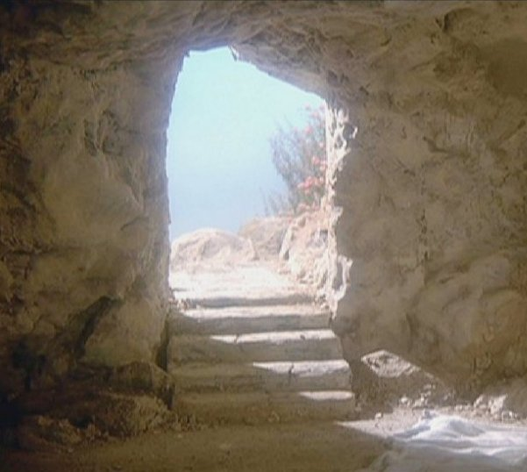
Jesus’ Tomb
What If?
Gen 1:26-27
Jn 1:1-18
Jn 19:40-42
1 Cor 15:3-23
Rom 1:20
Phil 2:5-11
Eph 5:13-14
4/20/25

Slide 2
What if there is a God who created the heavens, the earth, and all life in it?
In the beginning was the Word, and the Word was with God, and the Word was God. ² He was in the beginning with God. ³ All things were made through him, and without him was not any thing made that was made. ⁴ In him was life, and the life was the light of men. Jn 1:1-4

Slide 3
What if He created humankind uniquely, man and woman, in His own image and likeness to have a relationship with Him?

Slide 4
Then God said, “Let us make man in our image, after our likeness. And let them have dominion over the fish of the sea and over the birds of the heavens and over the livestock and over all the earth and over every creeping thing that creeps on the earth.” ²⁷ So God created man in his own image, in the image of God he created him; male and female he created them.
Gen 1:26-27

Slide 5
What if the first man (Adam), “did his own thing,” instead of following God’s simple instruction, and that he voluntarily received a sentence of death that affects all of us today?

Slide 6
But in fact, Christ has been raised from the dead, the firstfruits of those who have fallen asleep. ²¹ For as by a man came death, by a man has come also the resurrection of the dead. ²² For as in Adam all die, so also in Christ shall all be made alive. ²³ But each in his own order: Christ the firstfruits, then at his coming those who belong to Christ. 1 Cor 15:20-23

Slide 7
What if God has been revealing His plan to restore us to the original relationship that Adam and Eve enjoyed from the beginning?

Slide 8
What if this plan was that He Himself, as God, had to become a human by being born to a Jewish mother?

Slide 9
What if Jesus lived an innocent life, “doing life God’s way,” to break the curse of death that we all have over us?

Slide 10
Have this mind among yourselves, which is yours in Christ Jesus, ⁶ who, though he was in the form of God, did not count equality with God a thing to be grasped, ⁷ but emptied himself, by taking the form of a servant, being born in the likeness of men. ⁸ And being found in human form, he humbled himself by becoming obedient to the point of death, even death on a cross. Phil 2:5-8

Slide 11
What if Jesus was seen
by witnesses?
For I delivered to you as of first importance what I also received: that Christ died for our sins in accordance with the Scriptures, ⁴ that he was buried, that he was raised on the third day in accordance with the Scriptures, ⁵ and that he appeared to Cephas, then to the twelve. ⁶ Then he appeared to more than five hundred brothers at one time, most of whom are still alive, though some have fallen asleep. ⁷ Then he appeared to James, then to all the apostles. 1 Cor 15:3-7

Slide 12
What if Jesus really did rise from the dead ETERNALLY?
Therefore, God has highly exalted him and bestowed on him the name that is above every name, ¹⁰ so that at the name of Jesus every knee should bow, in heaven and on earth and under the earth, ¹¹ and every tongue confess that Jesus Christ is Lord, to the glory of God the Father. Phil 2:9-11

Slide 13


Slide 14
And He called a child to Himself and set him before them, ³ and said, “Truly I say to you, unless you are converted and become like children, you will not enter the kingdom of heaven. ⁴ “Whoever then humbles himself as this child, he is the greatest in the kingdom of heaven. ⁵ “And whoever receives one such child in My name receives Me; ⁶ but whoever causes one of these little ones who believe in Me to stumble, it would be better for him to have a heavy millstone hung around his neck, and to be drowned in the depth of the sea.”

Slide 15
Jesus makes heaven simple!
“See that you do not despise one of these little ones, for I say to you that their angels in heaven continually see the face of My Father who is in heaven. ¹¹ For the Son of Man has come to save that which was lost.”
Mt 18:2-11

Slide 16
Jesus desires you!
What do you think? If any man has a hundred sheep, and one of them has gone astray, does he not leave the ninety-nine on the mountains and go and search for the one that is straying? ¹³ If it turns out that he finds it, truly I say to you, he rejoices over it more than over the ninety-nine which have not gone astray. ¹⁴ So it is not the will of your Father who is in heaven that one of these little ones perish. Mt 18:12-14

Slide 17
Jesus’ arms are open
for you today!

