Slide 1
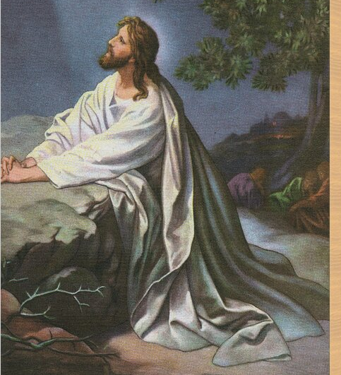
Journey to the Cross
Jn 7:6
Jn 13:1-8
Jn 18:1-19:37
Mt 26:36-46
4/13/25

Slide 2
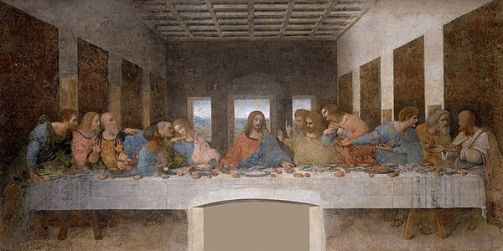
During supper, when the devil had already put it into the heart of Judas Iscariot, Simon’s son, to betray (Jesus) him, … Jn 13:2

Slide 3
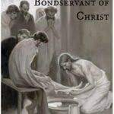
Then he poured water into a basin and began to wash the disciples’ feet and to wipe them with the towel that was wrapped around him. ⁶ He came to Simon Peter, who said to him, “Lord, do you wash my feet?”
⁷ Jesus answered him, “What I am doing you do not understand now, but afterward you will understand.” ⁸ Peter said to him, “You shall never wash my feet.” Jesus answered him, “If I do not wash you, you have no share with me.” Jn 13:3-8

Slide 4
Jesus went
to the garden.
Jn 18:1
When Jesus had spoken these words, he went out with his disciples across the brook Kidron, where there was a garden, which he and his disciples entered. ² Now Judas, who betrayed him, also knew the place, for Jesus often met there with his disciples. Jn 18:1

Slide 5
Jesus said, “I am he.”
So Judas, having procured a band of soldiers and some officers from the chief priests and the Pharisees, went there with lanterns and torches and weapons. ⁴ Then Jesus, knowing all that would happen to him, came forward and said to them, “Whom do you seek?” ⁵ They answered him, “Jesus of Nazareth.” Jesus said to them, “I am he.” Judas, who betrayed him, was standing with them. ⁶ When Jesus said to them, “I am he,” they drew back and fell to the ground. Jn 18:3-6

Slide 6
Peter in the Garden
Peter is caught napping
2. Peter, out of shame tries to prove his love for Jesus.
And taking with him Peter and the two sons of Zebedee, he began to be sorrowful and troubled. ³⁸ Then he said to them, “My soul is very sorrowful, even to death; remain here, and watch with me.” ³⁹ And going a little farther he fell on his face and prayed, saying, “My Father, if it be possible, let this cup pass from me; nevertheless, not as I will, but as you will.” Mt 26:37-39

Slide 7
And he came to the disciples and found them sleeping. And he said to Peter, “So, could you not watch with me one hour? ⁴¹ Watch and pray that you may not enter into temptation. The spirit indeed is willing, but the flesh is weak.”… ⁴⁴ So, leaving them again, he went away and prayed for the third time, saying the same words again. ⁴⁵ Then he came to the disciples and said to them, “Sleep and take your rest later on. See, the hour is at hand, and the Son of Man is betrayed into the hands of sinners. ⁴⁶ Rise, let us be going; see, my betrayer is at hand.”
Mt 26:40-41, 44-46

Slide 8
Jesus answered, “I told you that I am he. So, if you seek me, let these men go.” ⁹ This was to fulfill the word that he had spoken: “Of those whom you gave me I have lost not one.” ¹⁰ Then Simon Peter, having a sword, drew it and struck the high priest’s servant and cut off his right ear. (The servant’s name was Malchus.) ¹¹ So Jesus said to Peter, “Put your sword into its sheath; shall I not drink the cup that the Father has given me?” ¹² So the band of soldiers and their captain and the officers of the Jews arrested Jesus and bound him. Jn 18:8-12

Slide 9
Jesus was led to the
Chief Priests. Jn 18:15-17
Why do you ask me? Ask those who have heard me what I said to them; they know what I said.” ²² When he had said these things, one of the officers standing by struck Jesus with his hand, saying, “Is that how you answer the high priest?” ²³ Jesus answered him, “If what I said is wrong, bear witness about the wrong; but if what I said is right, why do you strike me?” ²⁴ Annas then sent him bound to Caiaphas the high priest. Jn 18:21-24

Slide 10
John snuck Peter into
the outer court. Jn 18:15-17
Simon Peter followed Jesus, and so did another disciple (John). Since John was known to the high priest, he entered with Jesus into the courtyard of the high priest, ¹⁶ but Peter stood outside at the door. So John, … went out and spoke to the servant girl who kept watch at the door, and brought Peter in. ¹⁷ The servant girl at the door said to Peter, “You also are not one of this man’s disciples, are you?” He said, “I am not.” Jn 18:15-17

Slide 11
Caiaphas sent Jesus
to Pilate. Jn 18:28
Jesus answered, “you
say that I am a king.” Jn 18:37

Slide 12
So Pilate… called Jesus and said to him, “Are you the King of the Jews?” ³⁴ Jesus answered, “Do you say this of your own accord, or did others say it to you about me?” … ³⁶ Jesus answered, “My kingdom is not of this world. If my kingdom were of this world, my servants would have been fighting… But my kingdom is not from the world.” ³⁷ Then Pilate said to him, “So you are a king?” Jesus answered, “You say that I am a king. For this purpose I was born and for this purpose I have come into the world—to bear witness to the truth. Everyone who is of the truth listens to my voice.” Jn 18:33-37 abv

Slide 13
Pilate wrote, Jesus the Nazarene, the King
of the Jews. Jn 19:15b-19 abv
The chief priests answered, “We have no king but Caesar.” ¹⁶ So he delivered him over to them to be crucified. So they took Jesus, ¹⁷ and he went out, bearing his own cross, to the place called The Place of a Skull… there they crucified him… ¹⁹ Pilate also wrote an inscription and put it on the cross. It read, “Jesus of Nazareth, the King of the Jews.”

Slide 14
Jesus knew the
scriptures. Jn 7:6, 13:3, 18:4, 19:28
^{7:6} Jesus said to them, “My time has not yet come, but your time is always here.” ^{13:3} Jesus, knowing that the Father had given all things into his hands, and that he had come from God and was going back to God. ^{18:4} Then Jesus, knowing all that would happen to him, came forward and said to them, “Whom do you seek?” ^{19:28} After this, Jesus, knowing that all was now finished, said (to fulfill the Scripture), “I thirst.”

Slide 15
Jesus, the Author
and Finisher of Our Faith
Therefore, since we are surrounded by so great a cloud of witnesses, let us also lay aside every weight, and sin which clings so closely, and let us run with endurance the race that is set before us, ² looking to Jesus, the founder and perfecter of our faith, who for the joy that was set before him endured the cross, despising the shame, and is seated at the right hand of the throne of God. Heb 12:1-2

Slide 16
Jesus, though he was in the form of God, did not count equality with God a thing to be grasped, ⁷ but emptied himself, by taking the form of a servant, being born in the likeness of men. ⁸ And being found in human form, he humbled himself by becoming obedient to the point of death, even death on a cross. ⁹ Therefore God has highly exalted him and bestowed on him the name that is above every name, ¹⁰ so that at the name of Jesus every knee should bow, in heaven and on earth and under the earth, ¹¹ and every tongue confess that Jesus Christ is Lord, to the glory of God the Father. Phil 2:6-11

