Slide 1
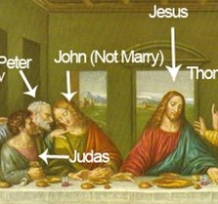
The Lord’s Last Supper
Jn 13:1-4
Jn 13:5-38
Mt 26:17-30
Mk 14:12-26
Lk 22:7-38
1 Cor 11:23-26
Heb 12:1-4
4/6/25

Slide 2
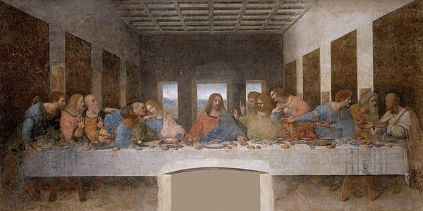
During supper, when the devil had already put it into the heart of Judas Iscariot, Simon’s son, to betray (Jesus) him, … Jn 13:2

Slide 3
The overriding testimony
of the Last Supper was
the love of Jesus. Jn 13:1, 4
Now before the Feast of the Passover, when Jesus knew that his hour had come to depart out of this world to the Father, having loved his own who were in the world, he loved them to the end. Jn 13:1

Slide 4
Jesus “Earnestly Desired” (lustily lusted)
over this meal!
And when the hour came, he reclined at table, and the apostles with him. ¹⁵ And he said to them, “I have “earnestly desired” to eat this Passover with you before I suffer. ¹⁶ For I tell you I will not eat it until it is fulfilled in the kingdom of God.” Lk 22:14-16

Slide 5
Therefore, since we are surrounded by so great a cloud of witnesses, let us also lay aside every weight, and sin which clings so closely, and let us run with endurance the race that is set before us, ² looking to Jesus, the founder and perfecter of our faith, who for the joy that was set before him endured the cross, despising the shame, and is seated at the right hand of the throne of God.
³ Consider him who endured from sinners such hostility against himself, so that you may not grow weary or fainthearted. ⁴ In your struggle against sin you have not yet resisted to the point of shedding your blood. Heb 12:1-4

Slide 6
Two other testimonies were present at the Supper; These were Self - Centeredness and Betrayal. Jn 13:2, Lk 22:21-23

Slide 7
1
But behold, the hand of him who betrays me is with me on the table… ²³ And they began to question one another, which of them it could be who was going to do this.
²⁴ A dispute also arose among them, as to which of them was to be regarded as the greatest. Lk 22:21, 23-24
2

Slide 8
Jesus’ testimony of love
is revealed in His example. Jn 13:5-17 (Jesus takes the towel)
But not so with you. Rather, let the greatest among you become as the youngest, and the leader as one who serves. ²⁷ For who is the greater, one who reclines at table or one who serves? Is it not the one who reclines at table? But I am among you as the one who serves. Lk 22:26-27

Slide 9
Jesus’ testimony of love
is revealed in His example. Jn 13:5-17 (Jesus takes the towel)
But not so with you. Rather, let the greatest among you become as the youngest, and the leader as one who serves. ²⁷ For who is the greater, one who reclines at table or one who serves? Is it not the one who reclines at table? But I am among you as the one who serves. Lk 22:26-27

Slide 10
Jesus’ testimony of love
is revealed in His Glory.
Jn 13:5-17 (Jesus takes the towel)
Jesus, knowing that the Father had given all things into his hands, and that he had come from God and was going back to God, ⁴ rose … ³¹ When he had gone out, Jesus said, “Now is the Son of Man glorified, and God is glorified in him. ³² If God is glorified in him, God will also glorify him in himself, and glorify him at once. Jn 13:3, 31-32

Slide 11
Jesus’ testimony of love
is revealed in His Spirit.
Little children, yet a little while I am with you… ‘Where I am going you cannot come.’… ¹⁶ And I will ask the Father, and he will give you another Helper, to be with you forever, ¹⁷ even the Spirit of truth, whom the world cannot receive, because it neither sees him nor knows him. You know him, for he dwells with you and will be in you. ¹⁸ “I will not leave you as orphans; I will come to you.” J
Jn 13:33abv, 14:16-18

Slide 12
Jesus’ testimony
of love is revealed by
His love in us!
A new commandment I give to you, that you love one another: just as I have loved you, you also are to love one another. ³⁵ By this all people will know that you are my disciples, if you have love for one another.” Jn 13:34-35

