Slide 1
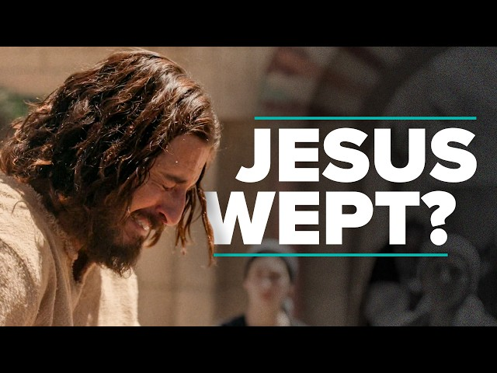
Processing Grief
The weight of death
Mt 14:12-15
Lk 7:12-15
Jn 11:32-35
Is 53:1-6
3/2/25

Slide 2
John’s Death
And his disciples came and took the body and buried it, and they went and told Jesus. ¹³ Now when Jesus heard this, he withdrew from there in a boat to a desolate place by himself. But when the crowds heard it, they followed him on foot from the towns.
Mt 14:12-13

Slide 3
NAIN: “Do not weep.”
As he drew near to the gate of the town, behold, a man who had died was being carried out, the only son of his mother, and she was a widow, and a considerable crowd from the town was with her. ¹³ And when the Lord saw her, he had compassion on her and said to her, “Do not weep.” ¹⁴ Then he came up and touched the bier, and the bearers stood still. And he said, “Young man, I say to you, arise.” ¹⁵ And the dead man sat up and began to speak, and Jesus gave him to his mother. Lk 7:12-15

Slide 4
Jesus Wept - Lazarus
Now when Mary came to where Jesus was and saw him, she fell at his feet, saying to him, “Lord, if you had been here, my brother would not have died.” ³³ When Jesus saw her weeping, and the Jews who had come with her also weeping, he was deeply moved in his spirit and greatly troubled. ³⁴ And he said, “Where have you laid him?” They said to him, “Lord, come and see.” ³⁵ Jesus wept. Jn 11:32-35

Slide 5
Grief was processed by:
Jesus. Mt 14:13
And his disciples came and took the body and buried it, and they went and told Jesus. ¹³ Now when Jesus heard this, he withdrew from there in a boat to a desolate place by himself. But when the crowds heard it, they followed him on foot from the towns.
Mt 14:12-13

Slide 6
Grief was processed by:
Herod. Mt 14:9
Prompted by her mother, she said, “Give me the head of John the Baptist here on a platter.” ⁹ And the king was sorry, but because of his oaths and his guests he commanded it to be given. ¹⁰ He sent and had John beheaded in the prison… Mt 14:8-10

Slide 7
Grief was processed by:
John’s disciples. Mt 14:12
And his disciples came and took the body and buried it, and they went and told Jesus.
Mt 14:12

Slide 8
Grief was processed by:
The multitude. Mt 14:13
Now when Jesus heard this, he withdrew from there in a boat to a desolate place by himself. But when the crowds heard it, they followed him on foot from the towns. ¹⁴ When he went ashore he saw a great crowd, and he had compassion on them and healed their sick. Mt 14:13-14

Slide 9
Grief was processed by:
Jesus’ disciples. Mt 14:15
When he went ashore he saw a great crowd, and he had compassion on them and healed their sick. ¹⁵ Now when it was evening, the disciples came to him and said, “This is a desolate place, and the day is now over; send the crowds away to go into the villages and buy food for themselves.” Mt 14:14-15

Slide 10
Jesus’ Grief
Who has believed what he has heard from us? And to whom has the arm of the LORD been revealed? ² For he grew up before him like a young plant, and like a root out of dry ground; he had no form or majesty that we should look at him, and no beauty that we should desire him. ³ He was despised and rejected by men, a man of sorrows and acquainted with grief; and as one from whom men hide their faces he was despised, and we esteemed him not. Is 53:1-3

Slide 11
Jesus’ Wounds = Healing
Surely he has borne our griefs and carried our sorrows; yet we esteemed him stricken, smitten by God, and afflicted. ⁵ But he was pierced for our transgressions; he was crushed for our iniquities; upon him was the chastisement that brought us peace, and with his wounds we are healed. ⁶ All we like sheep have gone astray; we have turned - every one - to his own way; and the LORD has laid on him the iniquity of us all.
Is 53:4-6

