Slide 1
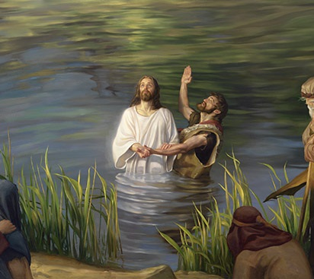
Who is Jesus?
John the Baptist, from the dead?
Mt 14:1-2, 3-12
Mk 16:14-29
Lk 3:19; 9:7-9
Rom 10:8-12
Rev 3:20
2/23/25

Slide 2
At that time Herod the tetrarch heard about the fame of Jesus, ² and he said to his servants, “This is John the Baptist. He has been raised from the dead; that is why these miraculous powers are at work in him.” ³ For Herod had seized John and bound him and put him in prison for the sake of Herodias, his brother Philip’s wife, ⁴ because John had been saying to him, “It is not lawful for you to have her.” ⁵ And though he wanted to put him to death, he feared the people, because they held him to be a prophet. Lk 3:18-20

Slide 3
But when Herod’s birthday came, the daughter of Herodias danced before the company and pleased Herod, ⁷ so that he promised with an oath to give her whatever she might ask. ⁸ Prompted by her mother, she said, “Give me the head of John the Baptist here on a platter.” ⁹ And the king was sorry, but because of his oaths and his guests he commanded it to be given. ¹⁰ He sent and had John beheaded in the prison, ¹¹ and his head was brought on a platter and given to the girl, and she brought it to her mother. Mt 14:6-11

Slide 4
Herod the Tetrarch / Herodias
Herod Antipas (son of Herod the Great - brother of Herod Archelaus) was Herod Philip’s half brother.
Herodias was the granddaughter of Herod the Great.
Herodias first married her Uncle, Herod Philip.
She left him to marry Uncle, Herod Antipas.

Slide 5
Herod controlled by
Power and Pleasure…
Pulled by Herodias’ overtures
Pulled by Salome’s (niece & step-daughter) dance
Pulled by the thoughts of those at his birthday party

Slide 6
John called out Herod. Mt 14:4, Lk 3:18-20
But Herod the tetrarch, who had been reproved by him for Herodias, his brother’s wife, and for all the evil things that Herod had done, ²⁰ added this to them all, that he locked up John in prison. Lk 3:18-20

Slide 7
Herod controlled by
Power and Pleasure…
Pulled by Herodias’ overtures
Pulled by Salome’s (niece & step-daughter) dance
Pulled by the thoughts of those at his birthday party
Pulled by John’s preaching!

Slide 8
Herod was afraid of:
Herodias. Mt 14:3
breaking his oath. Mt 14:7, 9
others. Mt 14:9

Slide 9
And the crowds asked him, “What then shall we do?” ¹¹ And he answered them, “Whoever has two tunics is to share with him who has none, and whoever has food is to do likewise.” ¹² Tax collectors also came to be baptized and said to him, “Teacher, what shall we do?” ¹³ And he said to them, “Collect no more than you are authorized to do.” ¹⁴ Soldiers also asked him, “And we, what shall we do?” And he said to them, “Do not extort money from anyone by threats or by false accusation, and be content with your wages.” Lk 3:10-14

Slide 10
As the people were in expectation, and all were questioning in their hearts concerning John, whether he might be the Christ, ¹⁶ John answered them all, saying, “I baptize you with water, but he who is mightier than I is coming, the strap of whose sandals I am not worthy to untie. He will baptize you with the Holy Spirit and fire. ¹⁷ His winnowing fork is in his hand, to clear his threshing floor and to gather the wheat into his barn, but the chaff he will burn with unquenchable fire.” Lk 3:15-17

Slide 11
Now Herod the tetrarch heard about all that was happening, and he was perplexed, because it was said by some that John had been raised from the dead, ⁸ by some that Elijah had appeared, and by others that one of the prophets of old had risen. ⁹ Herod said, “John I beheaded, but who is this about whom I hear such things?” And he sought to see him. Lk 9:7-9

