Slide 1
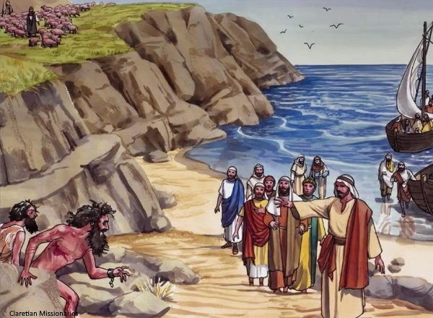
Following Jesus Part 3
A Legion, some Swine and a Deliverance
Lk 8:26-37
Mk 5:1-17
Mt 8:24-34
Mt 4:24
10/17/21

Slide 2
Legion is the ultimate bondage story.

Slide 3
Fear is the perceptible theme.

Slide 4
Fear is crippling because in it we are 100% Myopic!

Slide 5
Jesus desires to reveal His Power, Authority and Love when we are experiencing our maximum separation from Him and His plans. i.e. Fear!

Slide 6
And when he got into the boat, his disciples followed him. ²⁴ And behold, there arose a great storm on the sea, so that the boat was being swamped by the waves; but he was asleep. ²⁵ And they went and woke him, saying, “Save us, Lord; we are perishing.” Mt 8:23-25

Slide 7
And he said to them, “Why are you afraid, O you of little faith?” Then he rose and rebuked the winds and the sea, and there was a great calm. ²⁷ And the men marveled, saying, “What sort of man is this, that even winds and sea obey him?” Mt 8:26-27

Slide 8
Freedom
requires a
territorial battle!

Slide 9
Then they sailed to the country of the Gerasenes, which is opposite Galilee. ²⁷ When Jesus had stepped out on land, there met him a man from the city who had demons. For a long time he had worn no clothes, and he had not lived in a house but among the tombs. ²⁸ When he saw Jesus, he cried out and fell down before him and said with a loud voice… Lk 8:25-28a

Slide 10
“What have you to do with me, Jesus, Son of the Most High God? I beg you, do not torment me.” ²⁹ For he had com-manded the unclean spirit to come out of the man. (For many a time it had seized him. He was kept under guard and bound with chains and shackles, but he would break the bonds and be driven by the demon into the desert.) Lk 8:28-29

Slide 11
Jesus then asked him, “What is your name?” And he said, “Legion,” for many demons had entered him. ³¹ And they begged him not to command them to depart into the abyss. ³² Now a large herd of pigs was feeding there on the hillside, and they begged him to let them enter these. So, he gave them permission. Lk 8:30-32

Slide 12
Then the demons came out of the man and entered the pigs, and the herd rushed down the steep bank into the lake and drowned. ³⁴ When the herdsmen saw what had happened, they fled and told it in the city and in the country. ³⁵ Then people went out to see what had happened, and they came to Jesus and found the man from whom the demons had gone, sitting at the feet of Jesus, clothed and in his right mind, and they were afraid. Lk 8:33-35

Slide 13
And those who had seen it told them how the demon-possessed man had been healed. ³⁷ Then all the people of the surrounding country of the Gerasenes asked him to depart from them, for they were seized with great fear. So he got into the boat and returned.
Lk 8:36-37

Slide 14
Jesus
- Plan was in place “Freedom”
Warfare is not a distraction
“Sleep”
- Reveals:
Kingdom of God- Territorial Pursuit
Presence of God- Right Mind – Peace
Diverse “Follower” Directives

Slide 15
People of Gadara
- Message of “Freedom”
Territorial Stronghold – fear
- Fear
- Uncleanness

Slide 16
Disciples
- Fear Revelation
spirits and nature
clean and unclean
following and followers
Jesus and God
Authority and bondage
- Faith Revelation
not natural – not half-hearted

Slide 17
Following Jesus requires a kingdom reality check that:
- recognizes Jesus’ saving power & authority.

