Slide 1
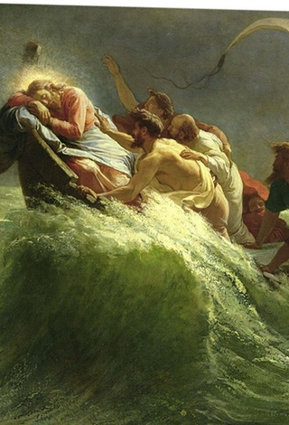
Following Jesus Part 2
Fear appendix
Mk 4:36-41
Mt 8:23-27
Lk 8:22-25
10/10/21

Slide 2
On that day, when evening had come, he said to them, “Let us go across to the other side.” ³⁶ And leaving the crowd, they took him with them in the boat, just as he was. And other boats were with him. ³⁷ And a great windstorm arose, and the waves were breaking into the boat, so that the boat was already filling. ³⁸ But he was in the stern, asleep on the cushion. And they woke him and said to him,
Mk 4:35-38a

Slide 3
“Teacher, do you not care that we are perishing?” ³⁹ And he awoke and rebuked the wind and said to the sea, “Peace! Be still!” And the wind ceased, and there was a great calm. ⁴⁰ He said to them, “Why are you so afraid? Have you still no faith?” ⁴¹ And they were filled with great fear and said to one another, “Who then is this, that even the wind and the sea obey him?” MK 4:38b-41

Slide 4
Fear not is scripture’s most used command.

Slide 5
On that day, when evening had come, he said to them, “Let us go across to the other side.” ³⁶ And leaving the crowd, they took him with them in the boat, just as he was. And other boats were with him. ³⁷ And a great windstorm arose, and the waves were breaking into the boat, so that the boat was already filling. ³⁸ But he was in the stern, asleep on the cushion. And they woke him and said to him,
Mk 4:35-38a

Slide 6
“Teacher, do you not care that we are perishing?” ³⁹ And he awoke and rebuked the wind and said to the sea, “Peace! Be still!” And the wind ceased, and there was a great calm. ⁴⁰ He said to them, “Why are you so afraid? Have you still no faith?” ⁴¹ And they were filled with great fear and said to one another, “Who then is this, that even the wind and the sea obey him?” MK 4:38b-41

Slide 7
Jesus addresses
the fear before stopping it’s source.
And they went and woke him, saying, “Save us, Lord; we are perishing.” And he said to them, “Why are you afraid, O you of little faith?” Then he rose and rebuked the winds and the sea, and there was a great calm. Mt 8:25-26

Slide 8
Faith is the
absence of fear.
And they went and woke him, saying, “Save us, Lord; we are perishing.” And he said to them, “Why are you afraid, O you of little faith?” Then he rose and rebuked the winds and the sea, and there was a great calm. Mt 8:25-26

Slide 9
By this we know that we abide in him and he in us, because he has given us of his Spirit. ¹⁴ And we have seen and testify that the Father has sent his Son to be the Savior of the world. ¹⁵ Whoever confesses that Jesus is the Son of God, God abides in him, and he in God. ¹⁶ So we have come to know and to believe the love that God has for us. 1 Jn 4:13-16a

Slide 10
God is love, and whoever abides in love abides in God, and God abides in him. ¹⁷ By this is love perfected with us, so that we may have confidence for the day of judgment, because as he is so also are we in this world. ¹⁸ There is no fear in love, but perfect love casts out fear. For fear has to do with punishment, and whoever fears has not been perfected in love.
1 Jn 4:16b-18

Slide 11
I wonder if…
Faith means looking at the right things & lack of faith means looking at the wrong things!

