Slide 1
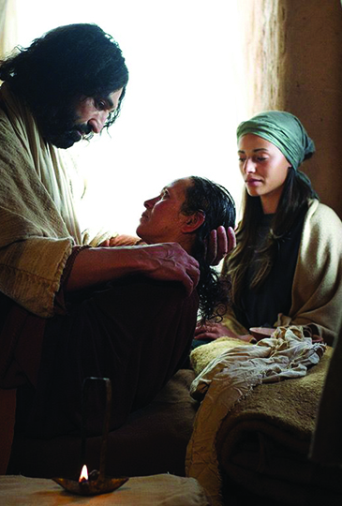
Peter’s
House!
Mt 8:14-17
Lk 4:38-41
Mk 1:29-34
Is 53
8/15/21

Slide 2
And when Jesus entered Peter’s house, he saw his mother-in-law lying sick with a fever. ¹⁵ He touched her hand, and the fever left her, and she rose and began to serve him. ¹⁶ That evening they brought to him many who were oppressed by demons, and he cast out the spirits with a word and healed all who were sick. ¹⁷ This was to fulfill what was spoken by the prophet Isaiah: “He took our illnesses and bore our diseases.” Mt 8:14-17

Slide 3
Jesus entered the house of Andrew and Peter.
And immediately he left the synagogue and entered the house of Simon and Andrew, with James and John. Mk 1:29

Slide 4
Jesus healed a “server.”
He touched her hand, and the fever left her, and she rose and began to serve him. Mt 8:15

Slide 5
And the whole city was gathered together at the door. ³⁴ And he healed many who were sick with various diseases, and cast out many demons. And he would not permit the demons to speak, because they knew him. Mk 1:32-34

Slide 6
The healing of a servant led to a revelation.
This was to fulfill what was spoken by the prophet Isaiah: “He took our illnesses and bore our diseases.”
Mt 8:17

Slide 7
Andrew and Peter’s House
1 Jesus serves the household by healing Peter’s mother-in-law
Peter’s M-I-L serves Jesus
3 The “DOOR” opens for Jesus to serve all who have needs
Jesus is revealed as
“The Suffering Servant” Is 53

Slide 8
Behold, my servant shall act wisely; he shall be high and lifted up, and shall be exalted. ¹⁴ As many were astonished at you - his appearance was so marred, beyond human semblance, and his form beyond that of the children of mankind ¹⁵ so shall he sprinkle many nations. Kings shall shut their mouths because of him, for that which has not been told them they see, and that which they have not heard they understand. Is 52:13-15

Slide 9
Jesus is God’s suffering servant.
Surely he has borne our griefs and carried our sorrows; yet we esteemed him stricken, smitten by God, and afflicted. ⁵ But he was pierced for our trans-
gressions; he was crushed for our iniquities; upon him was the chastisement that brought us peace, and with his wounds we are healed. Is 53:4-5

