Slide 1
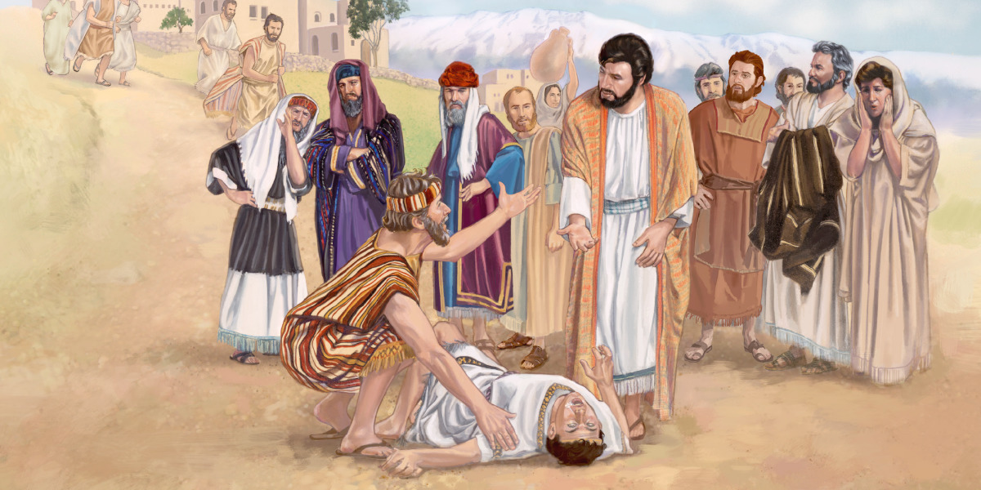
Amazed!
Bring Him
Mt 17:14-23
Lk 9:37-45
Mk 9:14-29
Key Verse Lk 9:43
8/1/21

Slide 2
Jesus and the Demonized Son
When it occurs
The background dynamics
Peter (Mark) account vs.
Matthew and Luke

Slide 3
And when Jesus finished these sayings, the crowds were astonished at his teaching, ²⁹ for he was teaching them as one who had authority, and not as their scribes. Mt 7:28-29

Slide 4
4th of 4 Jesus Interactions
1) Mt 19:16-30; 2) Mt 22:23-33; 3) Mk 7:31-37; 4) Lk 9:43
Astonished [Amazed]
1605. ἐκπλήσσω ekplḗssō; from ek (1537), an intens., and plḗssō (4141), to strike. To strike out, force out by a blow, but found only in the sense of knocking one out of his senses or self–possession, to strike with astonishment, terror, admiration. In the NT only in the pass., to be struck with astonishment, admiration, to be amazed.

Slide 5
Astonished [Amazed]
1568. ekthambéō;... To be greatly amazed or astonished from admiration (Mark 9:15); from terror (Mark 16:5, 6); from distress of mind (Mark 14:33) where it is parallel with lupéō (3076), to be sorry (Matt. 26:37).
Syn.: ekplḗssō (1605), to astonish, amaze

Slide 6
And when He came to the disciples, He saw a great multitude around them, and scribes disputing with them. ¹⁵ Immediately, when they saw Him, all the people were greatly amazed, and running to Him, greeted Him. ¹⁶ And He asked the scribes, “What are you discussing with them?” ¹⁷ Then one (a father) of the crowd answered and said, …
Mk 9:14-17a

Slide 7
“Teacher, I brought You my son, who has a mute spirit. And wherever it seizes him, it throws him down; he foams at the mouth, gnashes his teeth, and becomes rigid. So I spoke to Your disciples, that they should cast it out, but they could not.” ¹⁹ He answered him and said, “O faithless generation, how long shall I be with you? How long shall I bear with you? Bring him to Me.” Mk 9:18-19

Slide 8
Then they brought him to Him. And when he saw Him, immediately the spirit convulsed him, and he fell on the ground and wallowed, foaming at the mouth. ²¹ So He asked his father, “How long has this been happening to him?” And he said, “From childhood. ²² And often he has thrown him both into the fire and into the water to destroy him. But if You can do anything, have compassion on us and help us.” Mk 9:20-22

Slide 9
Jesus said to him, “If you can believe, all things are possible to him who believes.” ²⁴ Immediately the father of the child cried out and said with tears, “Lord, I believe; help my unbelief!” ²⁵ When Jesus saw that the people came running together, He rebuked the unclean spirit, saying to it, “Deaf and dumb spirit, I command you, come out of him and enter him no more!” Mk 9:23-25

Slide 10
Then the spirit cried out, convulsed him greatly, and came out of him. And he became as one dead, so that many said, “He is dead.” ²⁷ But Jesus took him by the hand and lifted him up, and he arose. ²⁸ And when He had come into the house, His disciples asked Him privately, “Why could we not cast it out?” ²⁹ So He said to them, “This kind can come out by nothing but prayer and fasting.” Mk 9:26-29

Slide 11
Jesus and the Demonized Son
When it occurs
  a Immediately after the transfiguration
  b Peter, James and John?

Slide 12
Jesus and the Demonized Son
When it occurs
The background dynamics
a Scribe & Disciple argument
b Disciples looking for status
c A desperate Father who has a son controlled by a spirit
d A faithless society v 19

Slide 13
Jesus and the Demonized Son
When it occurs
The background dynamics
Peter (Mark) account vs.
Matthew and Luke

Slide 14
3 Mark (Peter) Account
Scribes & Disciples argument 14
Transfigured Jesus Contrast 15
Spirit Identity (father/Jesus) 17, 25
Jesus seeing the Son (seizure) 20
Father Dialogue 21-24
Faith need 23-24
Response to Jesus’ rebuke 26
Prayer and Fasting Key to Faith
  Mt 17:20-21; Mk 9:28-29

Slide 15
We need the power of God, through prayer and fasting, to equip us for freedom giving ministry

