Slide 1
Citizens of the Kingdom

Slide 2
Citizens of the Kingdom
Once, on being asked by the Pharisees when the kingdom of God would come, Jesus replied, "The coming of the kingdom of God is not something that can be observed, nor will people say, 'Here it is,' or 'There it is,' because the kingdom of God is in your midst." (Luke 17:20-21)

Slide 3
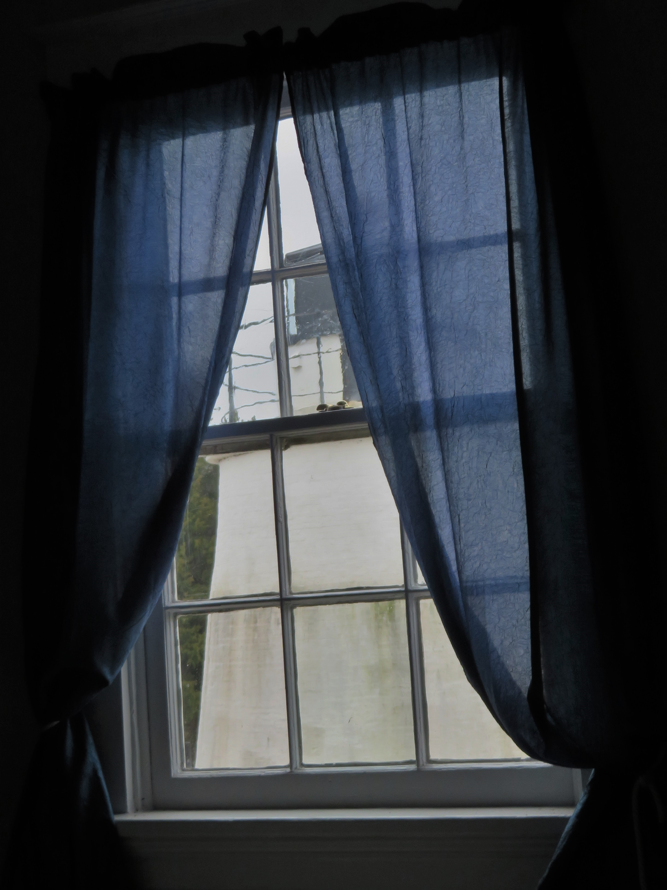
Citizens of the Kingdom

Slide 5
Citizens of the Kingdom
And Elisha prayed, "Open his eyes, LORD, so that he may see." Then the LORD opened the servant's eyes, and he looked and saw the hills full of horses and chariots of fire all around Elisha. (2 Kings 6:17)

Slide 6
Citizens of the Kingdom
"Not everyone who says to me, 'Lord, Lord,' will enter the kingdom of heaven, but only the one who does the will of my Father who is in heaven. Many will say to me on that day, 'Lord, Lord, did we not prophesy in your name and in your name drive out demons and in your name perform many miracles?' Then I will tell them plainly, 'I never knew you. Away from me, you evildoers!' (Matthew 7:21-23)

Slide 7
Citizens of the Kingdom
Some Jews who went around driving out evil spirits tried to invoke the name of the Lord Jesus over those who were demon- possessed. They would say, "In the name of the Jesus whom Paul preaches, I command you to come out."

Slide 8
Citizens of the Kingdom
Seven sons of Sceva, a Jewish chief priest, were doing this. One day the evil spirit answered them, "Jesus I know, and Paul I know about, but who are you?" Then the man who had the evil spirit jumped on them and overpowered them all. He gave them such a beating that they ran out of the house naked and bleeding. (Acts 19:13-16)

Slide 9
Citizens of the Kingdom
we must be
born again
like the woman with 10 coins … seeking
like the man who discovered a treasure
like the man entrusted with money
like the apostles and not the rich young ruler
ready to set everything else aside

Slide 10
Citizens of the Kingdom
we must
Be child-like

Slide 11
Citizens of the Kingdom
we must
Be child-like
Reject self-interest

Slide 12
Citizens of the Kingdom
The kingdom of heaven is like treasure hidden in a field. When a man found it, he hid it again, and then in his joy went and sold all he had and bought that field. (Matthew 13:44)

Slide 13
Citizens of the Kingdom
Do not suppose that I have come to bring peace to the earth. I did not come to bring peace, but a sword. For I have come to turn "'a man against his father, a daughter against her mother, a daughter-in-law against her mother-in-law— a man's enemies will be the members of his own household.'

Slide 14
Citizens of the Kingdom
"Anyone who loves their father or mother more than me is not worthy of me; anyone who loves their son or daughter more than me is not worthy of me. Whoever does not take up their cross and follow me is not worthy of me. Whoever finds their life will lose it, and whoever loses their life for my sake will find it. (Matthew 10:34-39)

Slide 15
Citizens of the Kingdom
we must
Be child-like
Reject self-interest
Share the Kingdom with anyone Jesus saves

Slide 16
Citizens of the Kingdom
He told them another parable: "The kingdom of heaven is like a mustard seed, which a man took and planted in his field. Though it is the smallest of all seeds, yet when it grows, it is the largest of garden plants and becomes a tree, so that the birds come and perch in its branches." (Matthew 13:31-32)

