Slide 1
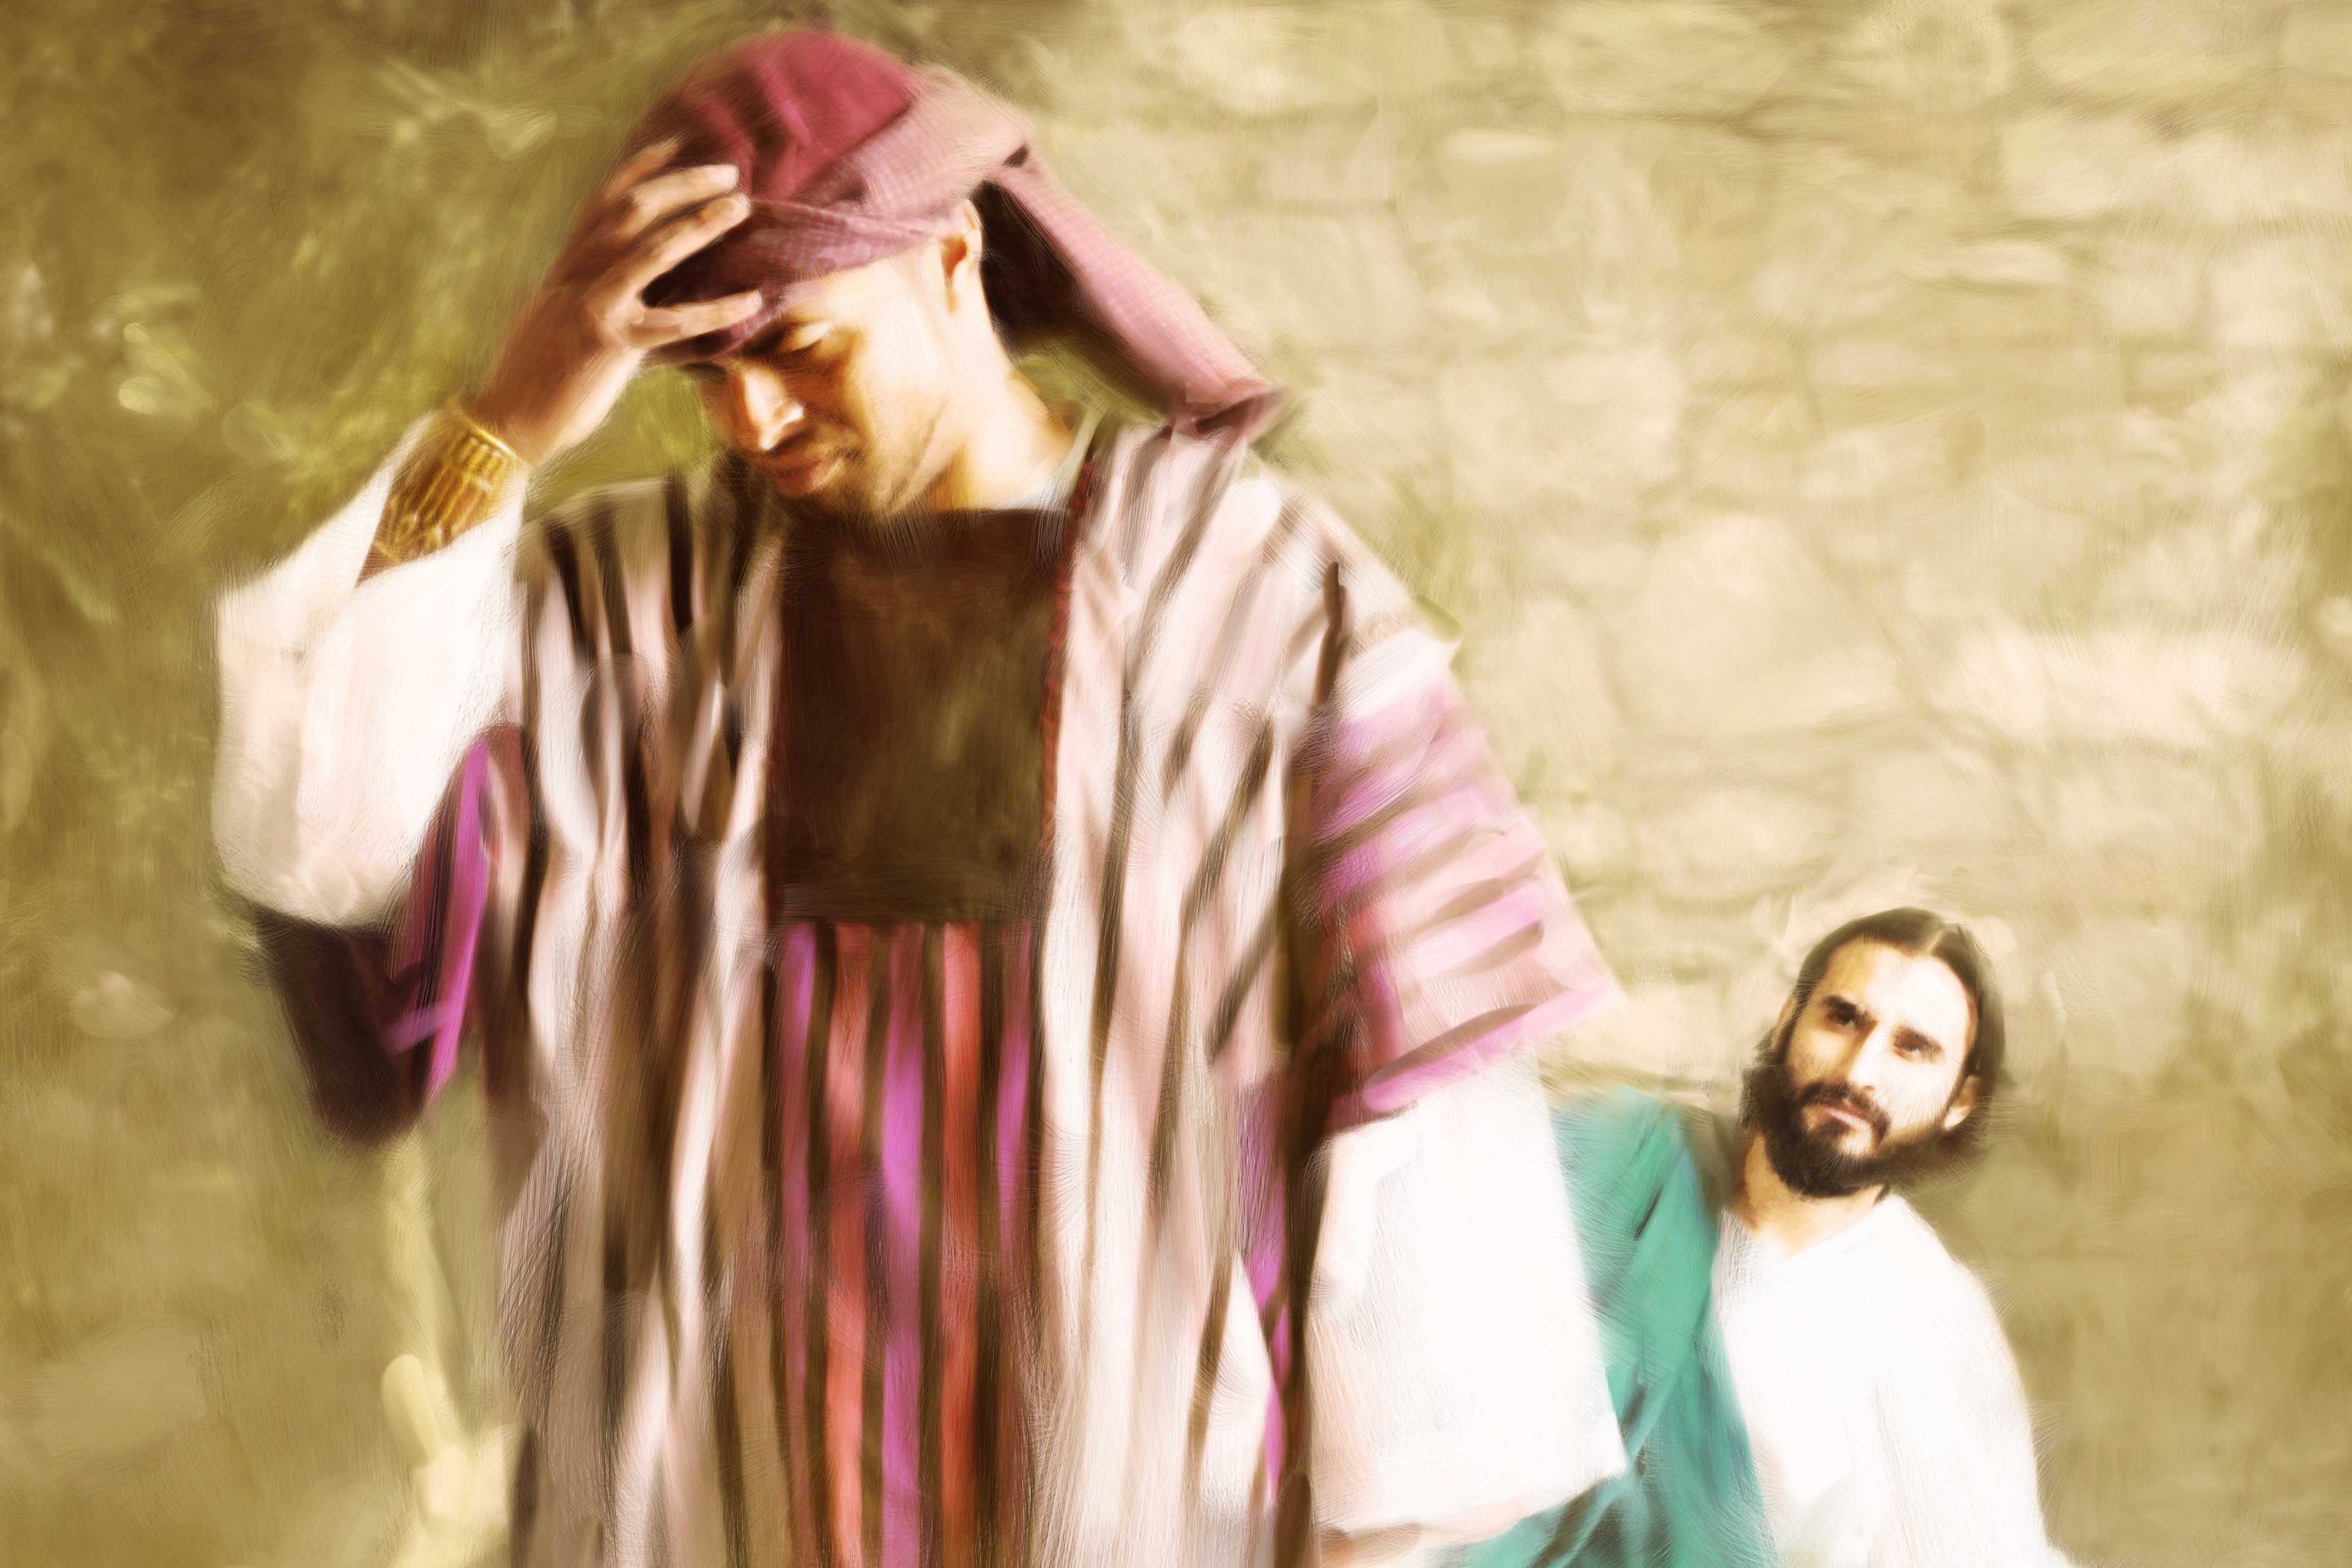
Amazed!
Rich Young Ruler
Amazed / Astounded / Astonished
Mt 7:28-29
Mt 19:16-30
Mk 10:17-27
Lk 18:18-27
6/27/21

Slide 2
And when Jesus finished these sayings, the crowds were astonished at his teaching, ²⁹ for he was teaching them as one who had authority, and not as their scribes. Mt 7:28-29

Slide 3
Astonished [Amazed]
1605. ἐκπλήσσω ekplḗssō; from ek (1537), an intens., and plḗssō (4141), to strike. To strike out, force out by a blow, but found only in the sense of knocking one out of his senses or self–possession, to strike with astonishment, terror, admiration. In the NT only in the pass., to be struck with astonishment, admiration, to be amazed

Slide 4
When the disciples heard this, they were greatly astonished, saying, “Who then can be saved?” ²⁶ But Jesus looked at them and said, “With man this is impossible, but with God all things are possible.”
Mt 19:25-26

Slide 5
Silently Read along with me
Mt 19:16-30

Slide 6
Who he (rich young ruler) is addressing!

Slide 7
And behold, a man came up to him, saying, “Teacher, what good deed must I do to have eternal life?” ¹⁷ And he said to him, “Why do you ask me about what is good? There is only one who is good. If you would enter life, keep the commandments.” Mt 19:16-17

Slide 8
Put a rectangle around the word GOOD (2x) in
Mt 19:17

Slide 9
What he (rich young ruler) is thinking about himself!

Slide 10
He said to him, “Which ones?” And Jesus said, “You shall not murder, You shall not commit adultery, You shall not steal, You shall not bear false witness, ¹⁹ Honor your father and mother, and… You shall love your neighbor as yourself.” ²⁰ The young man said to him, “All these I have kept. What do I still lack?”
Mt 19:18-20

Slide 11
Jesus said to him, “If you would be perfect, go, sell what you possess and give to the poor, and you will have treasure in heaven; and come, follow me.” ²² When the young man heard this he went away sorrowful, for he had great possessions. Mt 19:21-22

Slide 12
It’s easy to fool ourselves into thinking that we are Godly when are doing “God” things.

Slide 13
What he (rich young ruler) is thinking about eternity!

Slide 14
And Jesus said to his disciples, “Truly, I say to you, only with difficulty will a rich person enter the kingdom of heaven. ²⁴ Again I tell you, it is easier for a camel to go through the eye of a needle than for a rich person to enter the kingdom of God.” ²⁵ When the disciples heard this, they were greatly astonished, saying, “Who then can be saved?” ²⁶ But Jesus looked at them and said, “With man this is impossible, but with God all things are possible.” Mt 19:23-26

Slide 15
Heaven is not about doing “GOOD” with what you have. It is about giving up my “Earthly Likes” & trusting in God’s other kingdom GOODNESS!

Slide 16
And Jesus said to his disciples, “Truly, I say to you, only with difficulty will a rich person enter the kingdom of heaven. ²⁴ Again I tell you, it is easier for a camel to go through the eye of a needle than for a rich person to enter the kingdom of God.” ²⁵ When the disciples heard this, they were greatly astonished, saying, “Who then can be saved?” ²⁶ But Jesus looked at them and said, “With man this is impossible, but with God all things are possible.” Mt 19:23-26

Slide 17
Then Peter said in reply, “See, we have left everything and followed you. What then will we have?” ²⁸ Jesus said to them, “Truly, I say to you, in the new world, when the Son of Man will sit on his glorious throne, you who have followed me will also sit on twelve thrones, judging the twelve tribes of Israel.” Mt 19:27-28

Slide 18
Underline (in verse 28) “new world” and Jesus will sit on His glorious throne.

Slide 19
The Kingdom of Heaven will be a completely NEW world with an established, glorious king – JESUS!

Slide 20
“And everyone who has left houses or brothers or sisters or father or mother or children or lands, for my name’s sake, will receive a hundredfold and will inherit eternal life. ³⁰ But many who are first will be last, and the last first.” Mt 19:29-30

Slide 21
The paramount tie between the Kingdom of Heaven and this world will be that I think about others before I think about myself!

Slide 22
This man was doing GOOD things in a GOOD way.
… am I?

