Slide 1
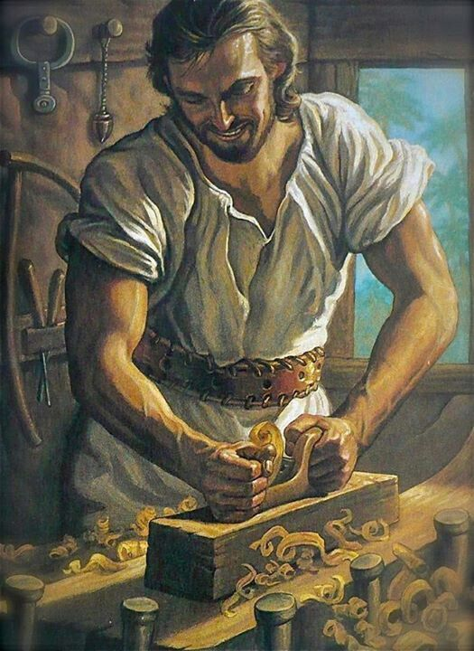
Joseph-
the man
Mt 1:18-25; 2:13-15, 19-23
12/5/20

Slide 2
Now the birth of Jesus Christ took place in this way. When his mother Mary had been betrothed to Joseph, before they “came together” she was found to be with child from the Holy Spirit. ¹⁹ And her husband Joseph, being a just man and unwilling to put her to shame, resolved to divorce her quietly. Mt 1:18-20a

Slide 3
Joseph’s wife Mary was pregnant by someone else.
Mt 1:18

Slide 4
Circumstance 1:
Joseph is engaged (married). He is a virgin. He was informed that his wife, Mary, is pregnant.
Response:
Joseph contemplates doing the “righteous” thing… to give her a “private divorce.” He is worried and anxious about this.

Slide 5
But as he considered these things, behold, an angel of the Lord appeared to him in a dream saying, “Joseph, son of David, do not fear to take Mary as your wife, for that which is conceived in her is from the Holy Spirit. ²¹ She will bear a son, and you shall call his name Jesus, for he will save his people from their sins.” ²² All this took place to fulfill what the Lord had spoken by the prophet: Mt 1:20-22

Slide 6
“Behold, the virgin shall conceive and bear a son, and they shall call his name Immanuel” (which means, God with us).
When Joseph woke from sleep, he did as the angel of the Lord commanded him: he took his wife, ²⁵ but knew her not until she had given birth to a son. And he called his name Jesus.
Mt 1:23-25

Slide 7
Circumstance 2 (Godly intervention):
An angel informs him that Mary is having God’s son.
Response:
Joseph changes his plan and marries Mary.
He doesn’t “come together” with Mary until after Jesus is born.

Slide 8
Now when they had departed …
Mt 2:13a

Slide 9
Circumstance 3:
Mary has healed and it is time to travel back home to Galilee.
Response:
Joseph packs the bags and begins a journey from where they are staying in Bethlehem.

Slide 10
Then Herod summoned the wise men secretly and ascertained from them what time the star had appeared… ¹⁶ Then Herod, when he saw that he had been tricked by the wise men, became furious, and he sent and killed all the male children in Bethlehem and in all that region who were two years old or under, according to the time that he had ascertained from the wise men. Mt 2:7, 16

Slide 11
Herod was about to kill every boy, living near Bethlehem, under the age of 2.
Mt 2:13

Slide 12
Now when they had departed, behold, an angel of the Lord appeared to Joseph in a dream and said, “Rise, take the child and his mother, and flee to Egypt, and remain there until I tell you, for Herod is about to search for the child, to destroy him.” Mt 2:13

Slide 13
And he rose and took the child and his mother by night and departed to Egypt ¹⁵ and remained there until the death of Herod. This was to fulfill what the Lord had spoken by the prophet, “Out of Egypt I called my son.” Mt 2:14-15

Slide 14
Circumstance 4 (Godly intervention):
Herod has been plotting to kill Jesus secretly. An angel informs Joseph to flee to Egypt.
Response:
Joseph changes his plan and heads to Egypt.
The message is so potent that he leaves immediately following the dream!

Slide 15
Herod the
murderer, died.
Mt 2:19

Slide 16
But when Herod died, behold, an angel of the Lord appeared in a dream to Joseph in Egypt, ²⁰ saying, “Rise, take the child and his mother and go to the land of Israel, for those who sought the child’s life are dead.” ²¹ And he rose and took the child and his mother and went to the land of Israel. Mt 2:19-21

Slide 17
Circumstance 5 (Godly intervention):
Joseph is informed by an angel that Herod is dead and that he is to go back to Israel.
Response:
Joseph leaves Egypt and begins a journey to Judea (probably Bethlehem) where Jesus was born.

Slide 18
But when he heard that Archelaus was reigning over Judea in place of his father Herod, he was afraid to go there… Mt 2:22a

Slide 19
Herod’s son Archelaus ruled in Judea.
Mt 2:22

Slide 20
Circumstance 6:
Joseph is informed that Herod’s son Archelaus was reigning over Judea.
Response:
Joseph is worried about living in Judea. He continued his journey to Judea with anxiety about it.

Slide 21
But when he heard that Archelaus was reigning over Judea in place of his father Herod, he was afraid to go there, and being warned in a dream he withdrew to the district of Galilee.
Mt 2:22

Slide 22
Circumstance 7 (Godly intervention):
Joseph is warned in a dream not to live in Judea.
Response:
Joseph enters Israel and heads to his home territory of Nazareth in Galilee.

Slide 23
“Joseph, son of David, do not fear to take Mary as your wife, for that which is conceived in her is from the Holy Spirit. ²¹ She will bear a son, and you shall call his name Jesus, for he will save his people from their sins.”
Mt 1:20-21

Slide 24
Whatever journey the Lord has you on…
He will not leave you or forsake you!
Heb 13:5

