Slide 1
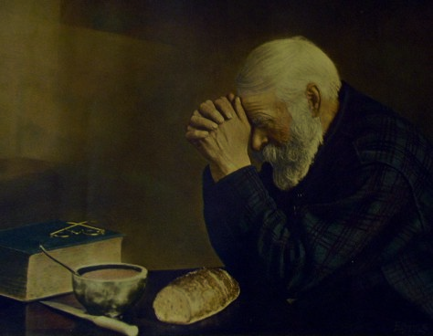
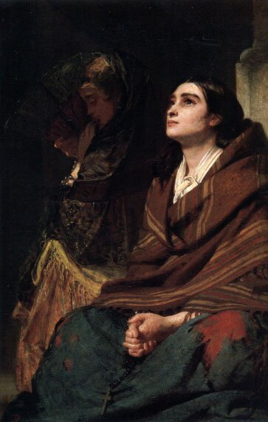
Prayer
ad Infinidum
Our Love – Our Christ
In Job

Slide 2
As a blameless and
innocent man Jesus
suffered...
humiliation,
disgrace,
and abandonment!

Slide 3
The Lord God has opened my ear,
and I was not rebellious; I turned not backward. ⁶ I gave my back to those who strike, and my cheeks to those who pull out the beard; I hid not my face from disgrace and spitting. ⁷ But the Lord God helps me; therefore I have not been disgraced; Is 50:5–7a

Slide 4
therefore I have set my face like a flint, and I know that I shall not be put to shame.
⁸ He who vindicates me is near.
Who will contend with me?
Let us stand up together.
Who is my adversary?
Let him come near to me. Is 50:7b–8

Slide 5
As a blameless and innocent man Jesus suffered...
grief, sorrow, physical judgment from God,
piercing, crushing, and whipping!

Slide 6
Surely he has borne our griefs
and carried our sorrows; yet we esteemed him stricken, smitten by God, and afflicted. ⁵ But he was pierced for our transgressions; he was crushed for our iniquities; upon him was the chastisement that brought us peace, and with his wounds we are healed. Is 53:4-5

Slide 7
...and abandonment!
He was despised and rejected by men, a man of sorrows and acquainted with grief; and as one from whom men hide their faces
he was despised, and we esteemed him not. Is 53:3

Slide 8
Job (as a type) uniquely reveals Jesus
as the innocent
Suffering Servant!
And the Lord said to Satan, “Have you considered my servant Job, that there is none like him on the earth, a blameless and upright man, who fears God and turns away from evil?” Job 1:8

Slide 9
Prayer Difficulties?
1 How do I understand little faith and moving a mountain? Mt 17:14-21
2 How do I understand suffering and seemingly cursed circumstances? Job

Slide 10
The relationship between faith and answers to prayer is a difficult one to understand.
Mt 17:14-21

Slide 11
“Why could we not
drive it out?”
The disciples tried to cast the demon out
The disciples were doing what Jesus with little faith
God the Father wanted the boy to be free
The faith of a miniscule mustard seed will move a mountain

Slide 12
How do I approach
God when everything
I touch seems to be cursed and I am blameless?
Job 31

Slide 13
I examine my heart!
There is a God
and He judges all
according to the heart!

Slide 14
Reflect on your heart’s actions regarding:
Lust
Sex, race, and class
Those in need: orphans, widows, and impoverished
Enemies and Strangers
Ungodly Supernatural Activity

Slide 15
“Forgive us our trespasses as we forgive those who trespass against us”
Receive and Breathe
Forgiveness!

Slide 16
I examine my
motives and trust!
I love (serve) God
no matter what!

Slide 17
Loving God means understanding Jesus’ subservience and ultimately His suffering.

Slide 18
Do nothing from selfish ambition or conceit, but in humility count others more significant than yourselves. ⁴ Let each of you look not only to his own interests, but also to the interests of others. ⁵ Have this mind among yourselves, which is yours in Christ Jesus, Phil 2:3-5

Slide 19
who, though he was in the form of God, did not count equality with God a thing to be grasped, ⁷ but emptied himself, by taking the form of a servant, being born in the likeness of men. ⁸ And being fou in human form, he humbled himself by becoming obedient to the point of death, even death on a cross. Phil 2:6-8

Slide 20
Christ Jesus’ humility, suffering, and sacrifice requires my _____________!

