Slide 1
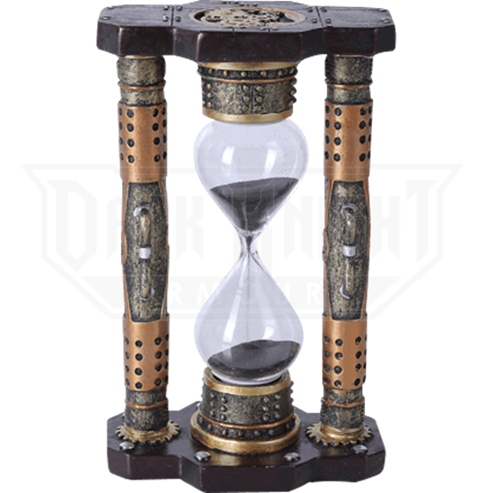
Seeds of Time Jesus, the 2nd
Coming & Tabernacles
Zech 13:7-9; 14:1-21
Mt 4:19; 24:3, 29-31; 25:31-34
Jn 21:15-19; Acts 1:9-11
Phil 2:6-11
1/19\\26/20

Slide 2
And when he had said these things, as they were looking on, he was lifted up, and a cloud took him out of their sight. ¹⁰ And while they were gazing into heaven as he went, behold, two men stood by them in white robes, ¹¹ and said, “Men of Galilee, why do you stand looking into heaven? This Jesus, who was taken up from you into heaven, will come in the same way as you saw him go into heaven.” Acts 1:9-11

Slide 3
The 3 hinges to understanding Jesus’ 2nd coming are the Cross, Jerusalem
& the Feast of Booths.

Slide 4
Who is Jesus to you?
A human who lived in Galilee 2000 years ago?
A fictitious person who represents good?
A man with a human body who was also God?

Slide 5
The cross is significant because it reveals a God who came miraculously (conceived and born of a woman without sex) to do the impossible (make a way for us to be holy heavenly beings)!

Slide 6
Jesus, though he was in the form of God, did not count equality with God a thing to be grasped, ⁷ but emptied himself, by taking the form of a servant, being born in the likeness of men. ⁸ And being found in human form, he humbled himself by becoming obedient to the point of death, even death on a cross. Phil 2:6-8

Slide 7
Therefore God has highly exalted him and bestowed on him the name that is above every name, ¹⁰ so that at the name of Jesus every knee should bow, in heaven and on earth and under the earth, ¹¹ and every tongue confess that Jesus Christ is Lord, to the glory of God the Father. Phil 2:9-11

Slide 8



Slide 9
Jesus ascended
into heaven & He will descend from heaven in the same way.

Slide 10
Peter’s “ascension” experience is understood through both his interactions with Jesus and with the feast of Sukkot (Tabernacles or Booths)

Slide 11
Follow me and you will Fish for Men
While walking by the Sea of Galilee, he saw two brothers, Simon (who is called Peter) and Andrew his brother, casting a net into the sea, for they were fishermen. ¹⁹ And he said to them, “Follow me, and I will make you fishers of men.” ²⁰ Immediately they left their nets and followed him. Mt 4:18-20
Jesus Interactions

Slide 12
Love me & you will feed my sheep
When they had finished breakfast, Jesus said to Simon Peter, “Simon, son of John, do you love me more than these?” He said to him, “Yes, Lord; you know that I love you.” He said to him, “Feed my lambs.” ¹⁶ He said to him a second time, “Simon, son of John, do you love me?”
Jn 21:15-16a
Jesus Interactions

Slide 13
Love me & you will feed my sheep
He said to him, “Yes, Lord; you know that I love you.” He said to him, “Tend my sheep.” ¹⁷ He said to him the third time, “Simon, son of John, do you love me?” Peter was grieved because he said to him the third time, “Do you love me?” and he said to him, “Lord, you know everything; you know that I love you.” Jn 21:16b-17a
Jesus Interactions

Slide 14
Love me & you will feed my sheep
Jesus said to him, “Feed my sheep. ¹⁸ Truly, truly, I say to you, when you were young, you used to dress yourself and walk wherever you wanted, but when you are old, you will stretch out your hands, and another will dress you and carry you where you do not want to go.” Jn 21:17b-18
Jesus Interactions

Slide 15
When I come again my sheep will inherit a kingdom prepared for them
“When the Son of Man comes in his glory, and all the angels with him, then he will sit on his glorious throne. ³² Before him will be gathered all the nations, and he will separate people one from another as a shepherd separates the sheep from the goats.” Mt 25:31-32
Jesus Interactions

Slide 16
When I come again my sheep will inherit a kingdom prepared for them
“And he will place the sheep on his right, but the goats on the left. ³⁴ Then the King will say to those on his right, ‘Come, you who are blessed by my Father, inherit the kingdom prepared for you from the foundation of the world.’”
Mt 25:31-32a
Jesus Interactions

Slide 17
Transfiguration
And after six days Jesus took with him Peter and James, and John his brother, and led them up a high mountain by themselves. ² And he was transfigured before them, and his face shone like the sun, and his clothes became white as light. ³ And behold, there appeared to them Moses and Elijah, talking with him. Mt 17:1-3
Sukkot Interactions

Slide 18
Transfiguration
And Peter said to Jesus, “Lord, it is good that we are here. If you wish, I will make three tents here, one for you and one for Moses and one for Elijah.” ⁵ He was still speaking when, behold, a bright cloud overshadowed them, and a voice from the cloud said, “This is my beloved Son, with whom I am well pleased; listen to him.” Mt 17:4-5
Sukkot Interactions

Slide 19
Transfiguration
When the disciples heard this, they fell on their faces and were terrified. ⁷ But Jesus came and touched them, saying, “Rise, and have no fear.” ⁸ And when they lifted up their eyes, they saw no one but Jesus only. Mt 17:6-7
Sukkot Interactions

Slide 20
What would you do if you were Peter?

Slide 21
So when they had come together, they asked him, “Lord, will you at this time restore the kingdom to Israel?” ⁷ He said to them, “It is not for you to know times or seasons that the Father has fixed by his own authority. ⁸ But you will receive power when the Holy Spirit has come upon you, and you will be my witnesses in Jerusalem and in all Judea and Samaria, and to the end of the earth.”
Acts 1:6-8

Slide 22
Jesus always gives us something to act upon, just like He did with Peter.

