Slide 1
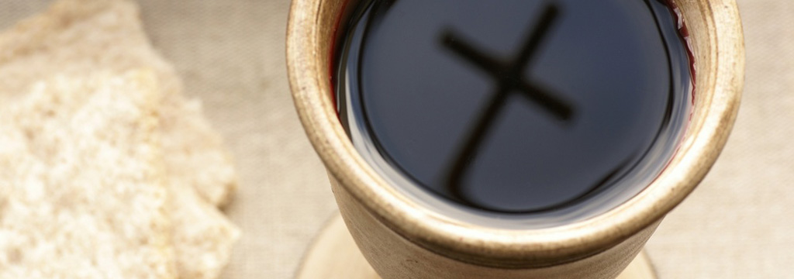
Risen

Slide 2
The Passover of the Jews was at hand, and Jesus went up to Jerusalem. ¹⁴ In the temple he found those who were selling oxen and sheep and pigeons, and the money-changers sitting there. ¹⁵ And making a whip of cords, he drove them all out of the temple, with the sheep and oxen. And he poured out the coins of the money-changers and overturned their tables. Jn 2:13-15

Slide 3
And he told those who sold the pigeons, “Take these things away; do not make my Father’s house a house of trade.” ¹⁷ His disciples remembered that it was written, “Zeal for your house will consume me.”
¹⁸ So the Jews said to him, “What sign do you show us for doing these things?” ¹⁹ Jesus answered them, “Destroy this temple, and in three days I will raise it up.” Jn 2:16-19

Slide 4
The Jews then said, “It has taken forty-six years to build this temple, and will you raise it up in three days?” ²¹ But he was speaking about the temple of his body. ²² When therefore he was raised from the dead, his disciples remembered that he had said this, and they believed the Scripture and the word that Jesus had spoken. Jn 2:20-22

Slide 5
Jesus was raised by Jesus?
Jesus answered them, “Destroy this temple, and in three days I will raise it up.” Jn 2:16-19

Slide 6
Jesus was raised by God, the Father?
Paul, an apostle—not from men nor through man, but through Jesus Christ and God the Father, who raised him from the dead—
Gal 1:1

Slide 7
Jesus was raised by the power of The Spirit?
that the God of our Lord Jesus Christ..., may give you the Spirit... ¹⁹ and what is the immeasurable greatness of his power toward us who believe, according to the working of his great might ²⁰ that he worked in Christ when he raised him from the dead... Eph 1:17-20abv

Slide 8
Jesus was raised
by God?
John 2:19; Galatians 1:1; Ephesians 1:17-20

Slide 9
The resurrection order is Christ (firstfruits) then those who belong to Christ?
1 Corinthians 15:23

Slide 10
But in fact Christ has been raised from the dead, the firstfruits of those who have fallen asleep. ²¹ For as by a man came death, by a man has come also the resurrection of the dead. ²² For as in Adam all die, so also in Christ shall all be made alive. ²³ But each in his own order: Christ the firstfruits, then at his coming those who belong to Christ.
1 Cor 15:20-23

Slide 11
... knowing that he who raised the Lord Jesus will raise us also with Jesus and bring us with you into his presence. ¹⁵ For it is all for your sake, so that as grace extends to more and more people it may increase thanksgiving, to the glory of God. 2 Cor 4:14-15

Slide 12
God will raise us with Jesus; and bring us into His presence.
2 Corinthians 4:14

Slide 13
Jesus rose from the dead to:
Establish LIFE in those who belong to Him!
Establish a relational presence is supernaturally intimate
* talking about “going to a place does not do justice to this wonderful work!

Slide 14
Jesus said to her, “Mary.” She turned and said to him in Aramaic, “Rabboni!” (Teacher). ¹⁷ Jesus said to her, “Do not cling to me, for I have not yet ascended to the Father; but go to my brothers and say to them, ‘I am ascending to my Father and your Father, to my God and your God.’ ” ¹⁸ Mary Magdalene went and announced to the disciples, “I have seen the Lord”- and that he had said these things to her.
Jn 20:16-18

Slide 15
Stay tuned...
for the rest of the story...
the ascension!

